Slide 1
第12章 查询执行

Slide 2
查询执行概述
查询执行模块的输入是物理执行计划 ，而输出则是可执行的编程代码，甚至是机器码。
查询执行模型的优化目标：以更短的时间来完成精确的查询。
对于这一目标有三种可行的方法：
（1） 通过合理规划减少总的指令数量。
（2） 减少循环数量，尽量在更少的循环数量中做更多的事。
（3） 并行处理查询：数据并行、计算并行

Slide 3
查询执行发展过程
火山模型 （1994）
向量化执行 （2005）
物化模型 （2000年左右）
源到源编译模型HIQUE（2010）
实时编译模型HYPER（2011）

Slide 4
目录
01
执行器概述
02
拉取式模型
03
推送式模型
04
并行执行
05
编译执行

Slide 5
查询执行框架
火山模型
编译执行
输入
查询计划
向量化执行
执行代码
机器码
输出
物化模型
Pull-based 拉取式
Push-based 推送式

Slide 6
拉取式模型 Pull-based
Open()
初始化
申请空间和设置连接、选择条件的参数
getNext()
获取下一条/一批记录
验证是否满足条件，若满足返回父节点；否则中止
Close()
清理
π_{Grade}
Open() {/* initialize variables */
b = first block of SC; // malloc a buffer
t = first tuple in block b;
}
σ_{Cno = 1}
S
getNext() {
IF (there is no next tuple in block b):
set b to next block;
IF(there is no next block): /* no more tuples */
RETURN NULL;
ELSE: t = first tuple in b;
next-first = t; /* return current tuple */
set t to next tuple in block b;
RETURN next-first;
}
SC
Close() { /* nothing to be done */
free the buffer of b;
}

Slide 7


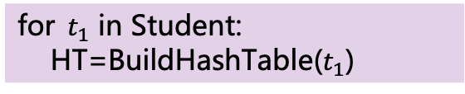
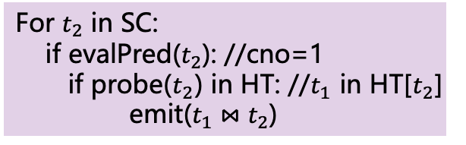

推送式模型 Push-based
$$Π$$
Sno,Sname,Grade
SELECT Sno, Sname, Grade
FROM SC, Student
WHERE SC.Sno = Student.Sno
AND Cno = "1"
For $t_{2}$ in SC:
if evalPred($t_{2}$): //cno=1
if probe($t_{2}$) in HT: //$t_{1}$ in HT[$t_{2}$] emit($t_{1}⋈t_{2}$)
$$⋈$$
SC.Sno = Student.Sno
$$σ$$
Cno = "1"
for${ t}_{1}$ in Student:
HT=BuildHashTable($t_{1}$)
Student
SC

Slide 8
拉取式模型与推送式模型
查询
输出
输出
聚合
聚合
调取数据
数据元组
数据元组
投影
投影
调取数据
数据元组
数据元组
谓词
谓词
调取数据
数据元组
数据元组
扫描
扫描
调取数据
数据元组
数据元组
数据集
数据集
拉取式模型
推送式模型

Slide 9
拉取式模型与推送式模型
 | 拉取式 | 推送式
开始节点 | 根节点 | 叶子节点
执行方向 | 自上而下 | 自下而上
核心 | 以算子为核心 | 以数据为核心
执行方式 | 通过函数从子节 点“拉取数据” | 将数据“推送”给 父节点
优势 | 省内存、易实现 | 效率高、易并行
劣势 | 函数调用多 | limit效率低，内存消耗高
输出
查询
输出
聚合
聚合
调取数据
数据元组
数据元组
投影
投影
调取数据
数据元组
数据元组
谓词
谓词
调取数据
数据元组
数据元组
扫描
扫描
调取数据
数据元组
数据元组
数据集
数据集
拉取式模型
推送式模型

Slide 10
目录
01
执行器概述
02
拉取式模型
03
推送式模型
04
并行执行
05
编译执行

Slide 11
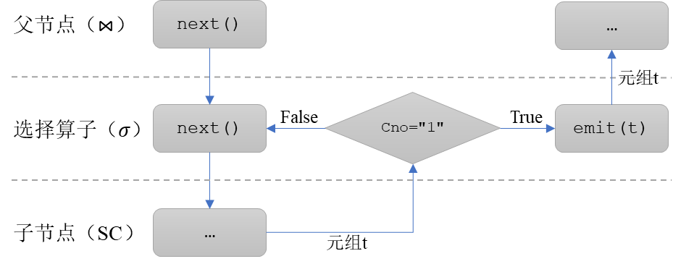
拉取式：火山 vs 物化 vs 向量化模型
火山
一次一元组
物化
一次所有元组
向量化
一次一批元组
函数调用:
Open()
GetNext()
Close()
π_{sname, cname, score}
控制流
数据流
⋈_{s.sid=sc.sid}
⋈_{sc.cid=c.cid}
S
σ_{cname = “DB”}
SC
C

Slide 12
火山模型
火山模型（volcano model）又被称为迭代模型（iterator model）或流水线模型（pipeline model）；
是一种以算子为核心，自上而下的拉取式的执行模型；
所有的算子都被视为独立执行的程序，并为它们提供了一个共同的应用程序接口，以方便拓展应用；
查询自上而下地通过next()函数递归调取数据元组，而元组流向则是自下而上。

Slide 13



火山模型示例
$$Π$$
查询获取“选修了1号课程的学生学号、姓名及成绩”
Sno,Sname,Grade
$$⋈$$
SC.Sno = Student.Sno
$$σ$$
SELECT Sno, Sname, Grade
FROM SC, Student
WHERE SC.Sno = Student.Sno
AND Cno = "1"
Cno = "1"
Student
SC
表达式树

Slide 14
火山模型执行流程
SELECT Sno, Sname, Grade
FROM SC, Student
WHERE SC.Sno = Student.Sno
AND Cno = "1"
for $t$ in child.next():
emit(projection($t$))
for $t_{1}$ in left.next():
BuildHashTable($t_{1}$)
for $t_{2}$ in right.next():
if probe($t_{2}$): emit($t_{1}⋈t_{2}$)
$$Π$$
Sno,Sname,Grade
$$⋈$$
SC.Sno = Student.Sno
for $t$ in child.next():
if evalPred($t$): emit($t$)
$$σ$$
Cno = "1"
for $t$ in SC:
emit($t$)
Student
SC
for $t$ in Student:
emit($t$)

Slide 15
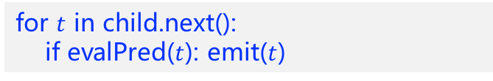

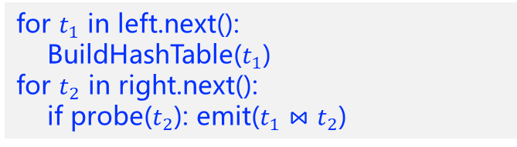
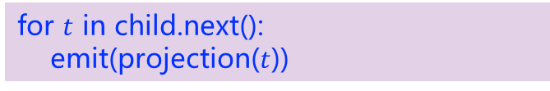

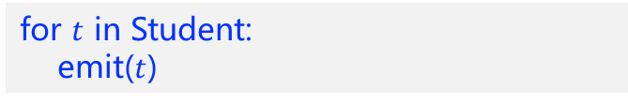

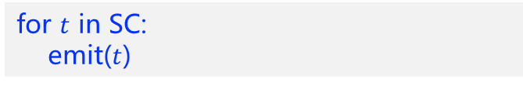
火山模型执行流程
SELECT Sno, Sname, Grade
FROM SC, Student
WHERE SC.Sno = Student.Sno
AND Cno = "1"
for $t$ in child.next():
emit(projection($t$))
$$Π$$
Sno,Sname,Grade
for $t_{1}$ in left.next():
BuildHashTable($t_{1}$)
for $t_{2}$ in right.next():
if probe($t_{2}$): emit($t_{1}⋈t_{2}$)
$$⋈$$
SC.Sno = Student.Sno
$$σ$$
for $t$ in child.next():
if evalPred($t$): emit($t$)
Cno = "1"
for $t$ in SC:
emit($t$)
Student
SC
for $t$ in Student:
emit($t$)

Slide 16
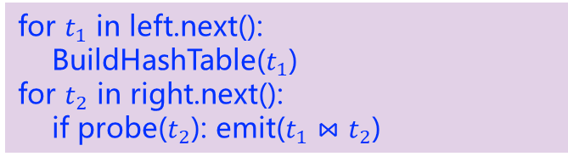
火山模型执行流程
SELECT Sno, Sname, Grade
FROM SC, Student
WHERE SC.Sno = Student.Sno
AND Cno = "1"
for $t$ in child.next():
emit(projection($t$))
$$Π$$
Sno,Sname,Grade
for $t_{1}$ in left.next():
BuildHashTable($t_{1}$)
for $t_{2}$ in right.next():
if probe($t_{2}$): emit($t_{1}⋈t_{2}$)
$$⋈$$
SC.Sno = Student.Sno
$$σ$$
for $t$ in child.next():
if evalPred($t$): emit($t$)
Cno = "1"
for $t$ in SC:
emit($t$)
Student
SC
for $t$ in Student:
emit($t$)

Slide 17
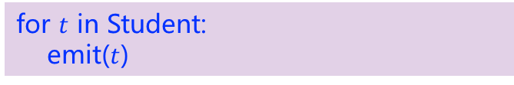
火山模型执行流程
SELECT Sno, Sname, Grade
FROM SC, Student
WHERE SC.Sno = Student.Sno
AND Cno = "1"
for $t$ in child.next():
emit(projection($t$))
$$Π$$
Sno,Sname,Grade
for $t_{1}$ in left.next():
BuildHashTable($t_{1}$)
for $t_{2}$ in right.next():
if probe($t_{2}$): emit($t_{1}⋈t_{2}$)
$$⋈$$
SC.Sno = Student.Sno
每次返回一条元组
$$σ$$
for $t$ in child.next():
if evalPred($t$): emit($t$)
Cno = "1"
for $t$ in SC:
emit($t$)
Student
SC
for $t$ in Student:
emit($t$)

Slide 18
火山模型执行流程
SELECT Sno, Sname, Grade
FROM SC, Student
WHERE SC.Sno = Student.Sno
AND Cno = "1"
for $t$ in child.next():
emit(projection($t$))
$$Π$$
Sno,Sname,Grade
for $t_{1}$ in left.next():
BuildHashTable($t_{1}$)
for $t_{2}$ in right.next():
if probe($t_{2}$): emit($t_{1}⋈t_{2}$)
$$⋈$$
SC.Sno = Student.Sno
$$σ$$
for $t$ in child.next():
if evalPred($t$): emit($t$)
Cno = "1"
for $t$ in SC:
emit($t$)
Student
SC
for $t$ in Student:
emit($t$)

Slide 19
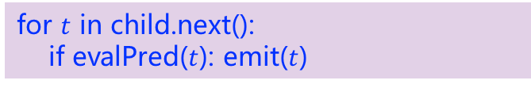
火山模型执行流程
SELECT Sno, Sname, Grade
FROM SC, Student
WHERE SC.Sno = Student.Sno
AND Cno = "1"
for $t$ in child.next():
emit(projection($t$))
$$Π$$
Sno,Sname,Grade
for $t_{1}$ in left.next():
BuildHashTable($t_{1}$)
for $t_{2}$ in right.next():
if probe($t_{2}$): emit($t_{1}⋈t_{2}$)
$$⋈$$
SC.Sno = Student.Sno
$$σ$$
for $t$ in child.next():
if evalPred($t$): emit($t$)
Cno = "1"
for $t$ in SC:
emit($t$)
Student
SC
for $t$ in Student:
emit($t$)

Slide 20
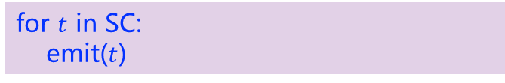
火山模型执行流程
SELECT Sno, Sname, Grade
FROM SC, Student
WHERE SC.Sno = Student.Sno
AND Cno = "1"
for $t$ in child.next():
emit(projection($t$))
$$Π$$
Sno,Sname,Grade
for $t_{1}$ in left.next():
BuildHashTable($t_{1}$)
for $t_{2}$ in right.next():
if probe($t_{2}$): emit($t_{1}⋈t_{2}$)
$$⋈$$
SC.Sno = Student.Sno
每次返回一条元组
$$σ$$
for $t$ in child.next():
if evalPred($t$): emit($t$)
Cno = "1"
for $t$ in SC:
emit($t$)
Student
SC
for $t$ in Student:
emit($t$)

Slide 21
火山模型执行流程
SELECT Sno, Sname, Grade
FROM SC, Student
WHERE SC.Sno = Student.Sno
AND Cno = "1"
for $t$ in child.next():
emit(projection($t$))
$$Π$$
Sno,Sname,Grade
for $t_{1}$ in left.next():
BuildHashTable($t_{1}$)
for $t_{2}$ in right.next():
if probe($t_{2}$): emit($t_{1}⋈t_{2}$)
$$⋈$$
SC.Sno = Student.Sno
每次返回一条元组
$$σ$$
for $t$ in child.next():
if evalPred($t$): emit($t$)
Cno = "1"
for $t$ in SC:
emit($t$)
Student
SC
for $t$ in Student:
emit($t$)

Slide 22
火山模型执行流程
SELECT Sno, Sname, Grade
FROM SC, Student
WHERE SC.Sno = Student.Sno
AND Cno = "1"
for $t$ in child.next():
emit(projection($t$))
每次返回一条元组
$$Π$$
Sno,Sname,Grade
for $t_{1}$ in left.next():
BuildHashTable($t_{1}$)
for $t_{2}$ in right.next():
if probe($t_{2}$): emit($t_{1}⋈t_{2}$)
$$⋈$$
SC.Sno = Student.Sno
$$σ$$
for $t$ in child.next():
if evalPred($t$): emit($t$)
Cno = "1"
for $t$ in SC:
emit($t$)
Student
SC
for $t$ in Student:
emit($t$)

Slide 23
火山模型执行流程
SELECT Sno, Sname, Grade
FROM SC, Student
WHERE SC.Sno = Student.Sno
AND Cno = "1"
for $t$ in child.next():
emit(projection($t$))
$$Π$$
Sno,Sname,Grade
for $t_{1}$ in left.next():
BuildHashTable($t_{1}$)
for $t_{2}$ in right.next():
if probe($t_{2}$): emit($t_{1}⋈t_{2}$)
$$⋈$$
SC.Sno = Student.Sno
$$σ$$
for $t$ in child.next():
if evalPred($t$): emit($t$)
Cno = "1"
for $t$ in SC:
emit($t$)
Student
SC
for $t$ in Student:
emit($t$)

Slide 24
物化模型
物化模型（Materialization Model）以数据为中心，自下而上地推送数据；
算子会将所有输入处理好后，将处理完的所有结果一次性输出；
输出既可以是完整的元组，也可以只包含其中部分的列。

Slide 25



物化模型示例
查询获取“选修了1号课程的学生学号、姓名及成绩”
$$Π$$
Sno,Sname,Grade
$$⋈$$
SC.Sno = Student.Sno
SELECT Sno, Sname, Grade
FROM SC, Student
WHERE SC.Sno = Student.Sno
AND Cno = "1"
$$σ$$
Cno = "1"
Student
SC
表达式树

Slide 26
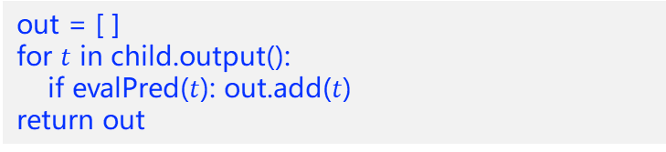

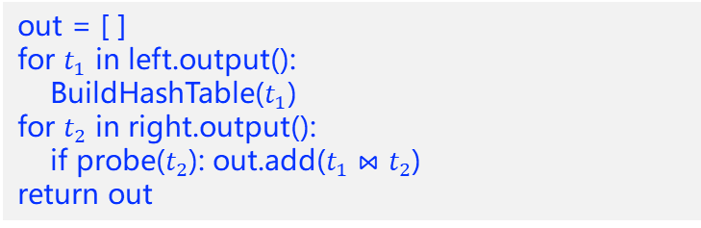
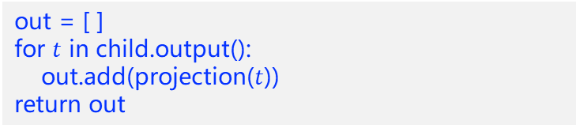

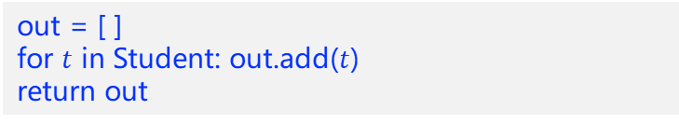

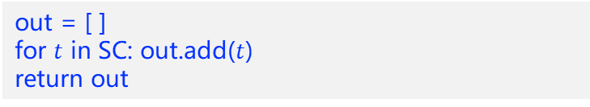
物化模型执行流程
SELECT Sno, Sname, Grade
FROM SC, Student
WHERE SC.Sno = Student.Sno
AND Cno = "1"
out = [ ]
for $t$ in child.output():
out.add(projection($t$))
return out
out = [ ]
for $t_{1}$ in left.output():
BuildHashTable($t_{1}$)
for $t_{2}$ in right.output():
if probe($t_{2}$): out.add($t_{1}⋈t_{2}$)
return out
$$Π$$
Sno,Sname,Grade
$$⋈$$
SC.Sno = Student.Sno
out = [ ]
for $t$ in child.output():
if evalPred($t$): out.add($t$)
return out
$$σ$$
Cno = "1"
out = [ ]
for $t$ in SC: out.add($t$)
return out
Student
SC
out = [ ]
for $t$ in Student: out.add($t$)
return out

Slide 27
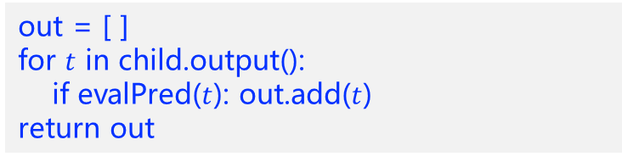

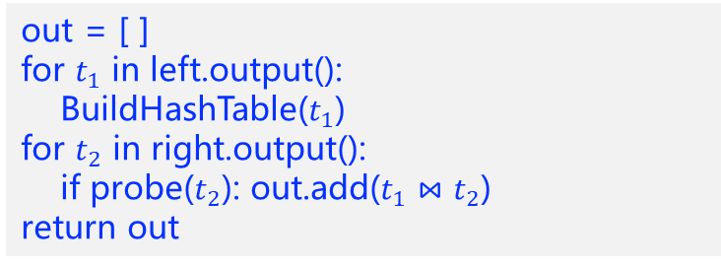
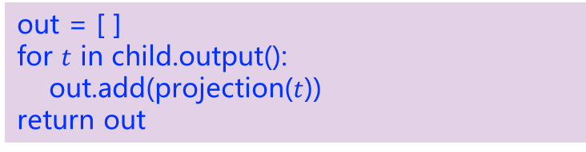

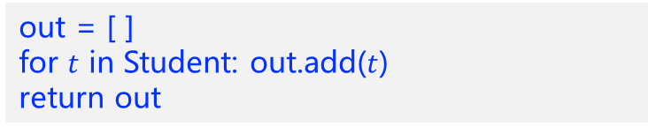

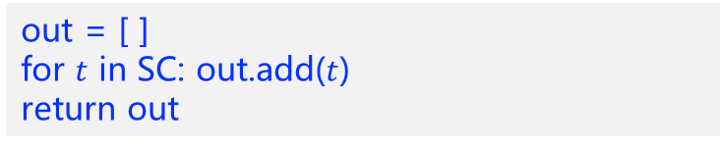
物化模型执行流程
out = [ ]
for $t$ in child.output():
out.add(projection($t$))
return out
SELECT Sno, Sname, Grade
FROM SC, Student
WHERE SC.Sno = Student.Sno
AND Cno = "1"
out = [ ]
for $t_{1}$ in left.output():
BuildHashTable($t_{1}$)
for $t_{2}$ in right.output():
if probe($t_{2}$): out.add($t_{1}⋈t_{2}$)
return out
$$Π$$
Sno,Sname,Grade
$$⋈$$
SC.Sno = Student.Sno
out = [ ]
for $t$ in child.output():
if evalPred($t$): out.add($t$)
return out
$$σ$$
Cno = "1"
out = [ ]
for $t$ in SC: out.add($t$)
return out
Student
SC
out = [ ]
for $t$ in Student: out.add($t$)
return out

Slide 28
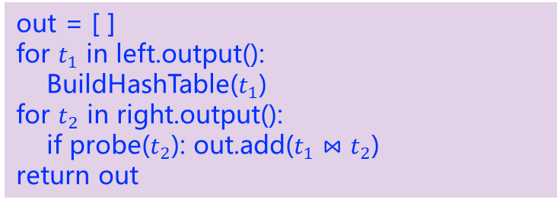
物化模型执行流程
out = [ ]
for $t$ in child.output():
out.add(projection($t$))
return out
SELECT Sno, Sname, Grade
FROM SC, Student
WHERE SC.Sno = Student.Sno
AND Cno = "1"
out = [ ]
for $t_{1}$ in left.output():
BuildHashTable($t_{1}$)
for $t_{2}$ in right.output():
if probe($t_{2}$): out.add($t_{1}⋈t_{2}$)
return out
$$Π$$
Sno,Sname,Grade
$$⋈$$
SC.Sno = Student.Sno
out = [ ]
for $t$ in child.output():
if evalPred($t$): out.add($t$)
return out
$$σ$$
Cno = "1"
out = [ ]
for $t$ in SC: out.add($t$)
return out
Student
SC
out = [ ]
for $t$ in Student: out.add($t$)
return out

Slide 29
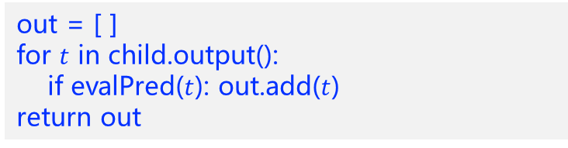
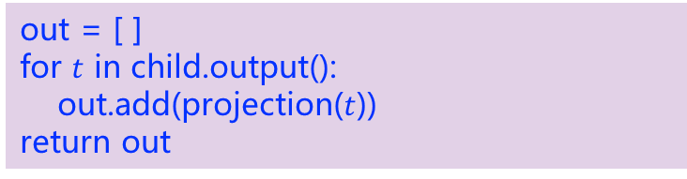
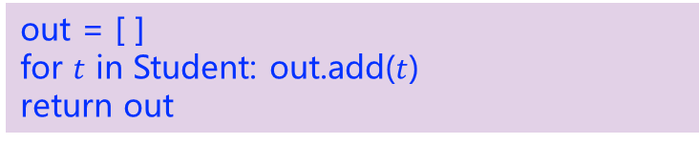
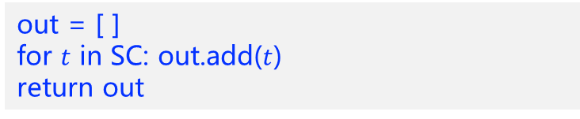
物化模型执行流程
out = [ ]
for $t$ in child.output():
out.add(projection($t$))
return out
SELECT Sno, Sname, Grade
FROM SC, Student
WHERE SC.Sno = Student.Sno
AND Cno = "1"
out = [ ]
for $t_{1}$ in left.output():
BuildHashTable($t_{1}$)
for $t_{2}$ in right.output():
if probe($t_{2}$): out.add($t_{1}⋈t_{2}$)
return out
$$Π$$
Sno,Sname,Grade
$$⋈$$
SC.Sno = Student.Sno
out = [ ]
for $t$ in child.output():
if evalPred($t$): out.add($t$)
return out
返回全部元组
$$σ$$
Cno = "1"
out = [ ]
for $t$ in SC: out.add($t$)
return out
Student
SC
out = [ ]
for $t$ in Student: out.add($t$)
return out

Slide 30

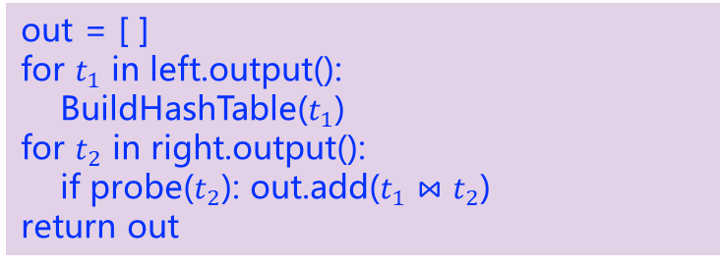
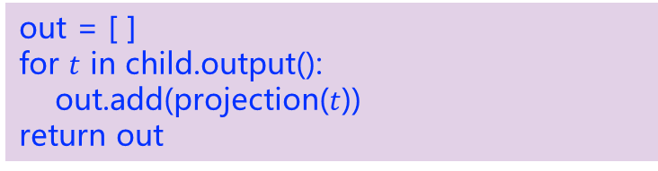
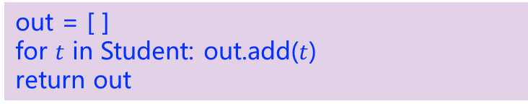
物化模型执行流程
out = [ ]
for $t$ in child.output():
out.add(projection($t$))
return out
SELECT Sno, Sname, Grade
FROM SC, Student
WHERE SC.Sno = Student.Sno
AND Cno = "1"
out = [ ]
for $t_{1}$ in left.output():
BuildHashTable($t_{1}$)
for $t_{2}$ in right.output():
if probe($t_{2}$): out.add($t_{1}⋈t_{2}$)
return out
$$Π$$
Sno,Sname,Grade
$$⋈$$
SC.Sno = Student.Sno
out = [ ]
for $t$ in child.output():
if evalPred($t$): out.add($t$)
return out
$$σ$$
Cno = "1"
out = [ ]
for $t$ in SC: out.add($t$)
return out
Student
SC
out = [ ]
for $t$ in Student: out.add($t$)
return out

Slide 31
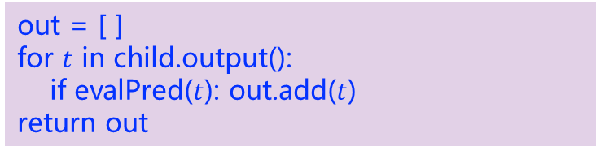




物化模型执行流程
out = [ ]
for $t$ in child.output():
out.add(projection($t$))
return out
SELECT Sno, Sname, Grade
FROM SC, Student
WHERE SC.Sno = Student.Sno
AND Cno = "1"
out = [ ]
for $t_{1}$ in left.output():
BuildHashTable($t_{1}$)
for $t_{2}$ in right.output():
if probe($t_{2}$): out.add($t_{1}⋈t_{2}$)
return out
$$Π$$
Sno,Sname,Grade
$$⋈$$
SC.Sno = Student.Sno
out = [ ]
for $t$ in child.output():
if evalPred($t$): out.add($t$)
return out
$$σ$$
Cno = "1"
out = [ ]
for $t$ in SC: out.add($t$)
return out
Student
SC
out = [ ]
for $t$ in Student: out.add($t$)
return out

Slide 32
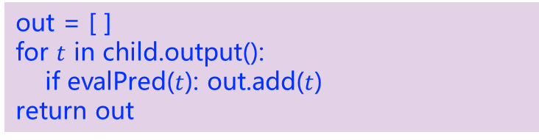



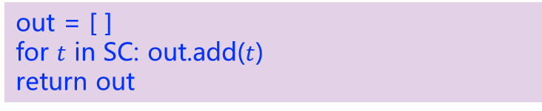
物化模型执行流程
out = [ ]
for $t$ in child.output():
out.add(projection($t$))
return out
SELECT Sno, Sname, Grade
FROM SC, Student
WHERE SC.Sno = Student.Sno
AND Cno = "1"
out = [ ]
for $t_{1}$ in left.output():
BuildHashTable($t_{1}$)
for $t_{2}$ in right.output():
if probe($t_{2}$): out.add($t_{1}⋈t_{2}$)
return out
$$Π$$
Sno,Sname,Grade
$$⋈$$
SC.Sno = Student.Sno
out = [ ]
for $t$ in child.output():
if evalPred($t$): out.add($t$)
return out
返回全部元组
$$σ$$
Cno = "1"
out = [ ]
for $t$ in SC: out.add($t$)
return out
Student
SC
out = [ ]
for $t$ in Student: out.add($t$)
return out

Slide 33

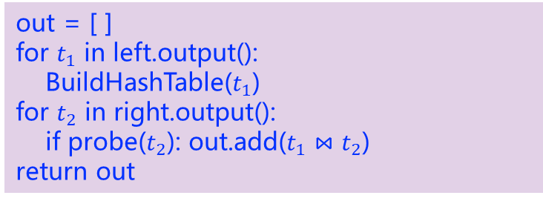

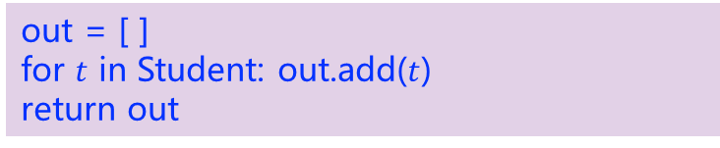
物化模型执行流程
out = [ ]
for $t$ in child.output():
out.add(projection($t$))
return out
SELECT Sno, Sname, Grade
FROM SC, Student
WHERE SC.Sno = Student.Sno
AND Cno = "1"
out = [ ]
for $t_{1}$ in left.output():
BuildHashTable($t_{1}$)
for $t_{2}$ in right.output():
if probe($t_{2}$): out.add($t_{1}⋈t_{2}$)
return out
$$Π$$
Sno,Sname,Grade
返回全部元组
$$⋈$$
SC.Sno = Student.Sno
out = [ ]
for $t$ in child.output():
if evalPred($t$): out.add($t$)
return out
$$σ$$
Cno = "1"
out = [ ]
for $t$ in SC: out.add($t$)
return out
Student
SC
out = [ ]
for $t$ in Student: out.add($t$)
return out

Slide 34
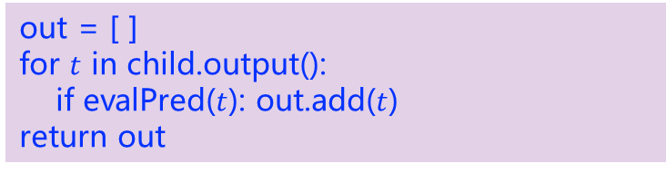
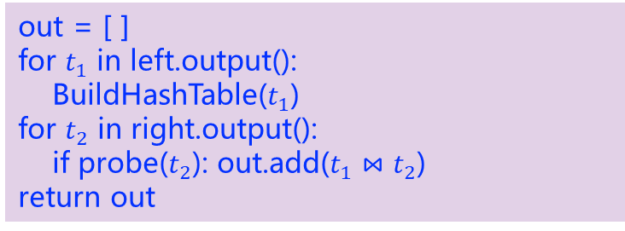
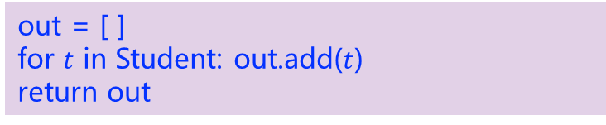
物化模型执行流程
SELECT Sno, Sname, Grade
FROM SC, Student
WHERE SC.Sno = Student.Sno
AND Cno = "1"
out = [ ]
for $t$ in child.output():
out.add(projection($t$))
return out
返回全部元组
out = [ ]
for $t_{1}$ in left.output():
BuildHashTable($t_{1}$)
for $t_{2}$ in right.output():
if probe($t_{2}$): out.add($t_{1}⋈t_{2}$)
return out
$$Π$$
Sno,Sname,Grade
$$⋈$$
SC.Sno = Student.Sno
out = [ ]
for $t$ in child.output():
if evalPred($t$): out.add($t$)
return out
$$σ$$
Cno = "1"
out = [ ]
for $t$ in SC: out.add($t$)
return out
Student
SC
out = [ ]
for $t$ in Student: out.add($t$)
return out

Slide 35
向量化执行模型
向量化执行模型（Vectorization Model）可以在一定程度上被视为火山模型与物化模型的中间形态；
通过next()函数自上而下地拉取数据，每次会拉取一个批次的元组数据，而不是只有一个。

Slide 36



向量化执行模型示例
$$Π$$
Sno,Sname,Grade
查询获取“选修了1号课程的学生学号、姓名及成绩”
$$⋈$$
SC.Sno = Student.Sno
$$σ$$
SELECT Sno, Sname, Grade
FROM SC, Student
WHERE SC.Sno = Student.Sno
AND Cno = "1"
Cno = "1"
Student
SC
表达式树

Slide 37
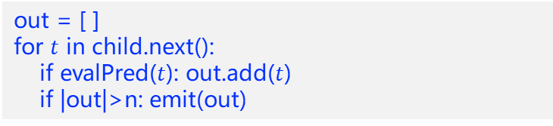

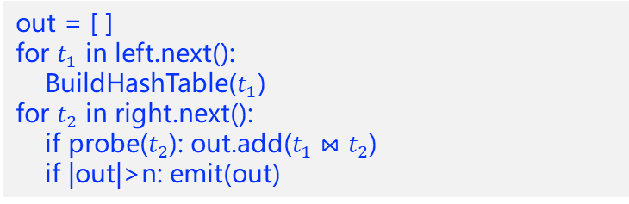
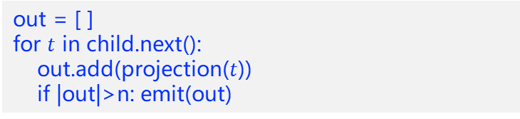

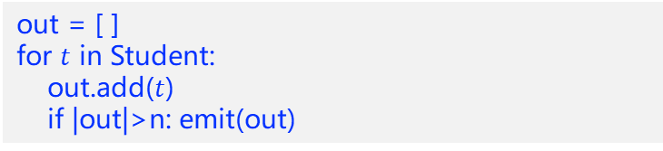

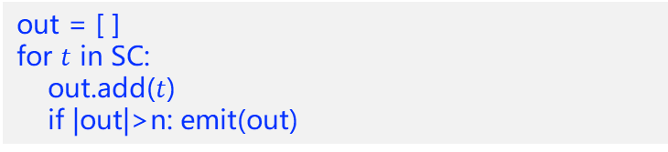
向量化执行模型执行流程
SELECT Sno, Sname, Grade
FROM SC, Student
WHERE SC.Sno = Student.Sno
AND Cno = "1"
out = [ ]
for $t$ in child.next():
out.add(projection($t$))
if |out|>n: emit(out)
$$Π$$
out = [ ]
for $t_{1}$ in left.next():
BuildHashTable($t_{1}$)
for $t_{2}$ in right.next():
if probe($t_{2}$): out.add($t_{1}⋈t_{2}$)
if |out|>n: emit(out)
Sno,Sname,Grade
$$⋈$$
SC.Sno = Student.Sno
out = [ ]
for $t$ in child.next():
if evalPred($t$): out.add($t$)
if |out|>n: emit(out)
$$σ$$
Cno = "1"
out = [ ]
for $t$ in SC:
out.add($t$)
if |out|>n: emit(out)
Student
SC
out = [ ]
for $t$ in Student:
out.add($t$)
if |out|>n: emit(out)

Slide 38



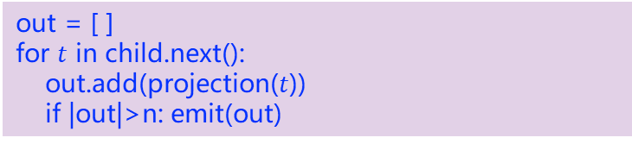



向量化执行模型执行流程
out = [ ]
for $t$ in child.next():
out.add(projection($t$))
if |out|>n: emit(out)
SELECT Sno, Sname, Grade
FROM SC, Student
WHERE SC.Sno = Student.Sno
AND Cno = "1"
out = [ ]
for $t_{1}$ in left.next():
BuildHashTable($t_{1}$)
for $t_{2}$ in right.next():
if probe($t_{2}$): out.add($t_{1}⋈t_{2}$)
if |out|>n: emit(out)
$$Π$$
Sno,Sname,Grade
$$⋈$$
SC.Sno = Student.Sno
out = [ ]
for $t$ in child.next():
if evalPred($t$): out.add($t$)
if |out|>n: emit(out)
$$σ$$
Cno = "1"
out = [ ]
for $t$ in SC:
out.add($t$)
if |out|>n: emit(out)
Student
SC
out = [ ]
for $t$ in Student:
out.add($t$)
if |out|>n: emit(out)

Slide 39







向量化执行模型执行流程
out = [ ]
for $t$ in child.next():
out.add(projection($t$))
if |out|>n: emit(out)
SELECT Sno, Sname, Grade
FROM SC, Student
WHERE SC.Sno = Student.Sno
AND Cno = "1"
out = [ ]
for $t_{1}$ in left.next():
BuildHashTable($t_{1}$)
for $t_{2}$ in right.next():
if probe($t_{2}$): out.add($t_{1}⋈t_{2}$)
if |out|>n: emit(out)
$$Π$$
Sno,Sname,Grade
$$⋈$$
SC.Sno = Student.Sno
out = [ ]
for $t$ in child.next():
if evalPred($t$): out.add($t$)
if |out|>n: emit(out)
$$σ$$
Cno = "1"
out = [ ]
for $t$ in SC:
out.add($t$)
if |out|>n: emit(out)
Student
SC
out = [ ]
for $t$ in Student:
out.add($t$)
if |out|>n: emit(out)

Slide 40







向量化执行模型执行流程
out = [ ]
for $t$ in child.next():
out.add(projection($t$))
if |out|>n: emit(out)
SELECT Sno, Sname, Grade
FROM SC, Student
WHERE SC.Sno = Student.Sno
AND Cno = "1"
out = [ ]
for $t_{1}$ in left.next():
BuildHashTable($t_{1}$)
for $t_{2}$ in right.next():
if probe($t_{2}$): out.add($t_{1}⋈t_{2}$)
if |out|>n: emit(out)
$$Π$$
Sno,Sname,Grade
$$⋈$$
SC.Sno = Student.Sno
out = [ ]
for $t$ in child.next():
if evalPred($t$): out.add($t$)
if |out|>n: emit(out)
返回一批的元组
$$σ$$
Cno = "1"
out = [ ]
for $t$ in SC:
out.add($t$)
if |out|>n: emit(out)
Student
SC
out = [ ]
for $t$ in Student:
out.add($t$)
if |out|>n: emit(out)

Slide 41
向量化执行模型执行流程
out = [ ]
for $t$ in child.next():
out.add(projection($t$))
if |out|>n: emit(out)
SELECT Sno, Sname, Grade
FROM SC, Student
WHERE SC.Sno = Student.Sno
AND Cno = "1"
out = [ ]
for $t_{1}$ in left.next():
BuildHashTable($t_{1}$)
for $t_{2}$ in right.next():
if probe($t_{2}$): out.add($t_{1}⋈t_{2}$)
if |out|>n: emit(out)
$$Π$$
Sno,Sname,Grade
$$⋈$$
SC.Sno = Student.Sno
out = [ ]
for $t$ in child.next():
if evalPred($t$): out.add($t$)
if |out|>n: emit(out)
$$σ$$
Cno = "1"
out = [ ]
for $t$ in SC:
out.add($t$)
if |out|>n: emit(out)
Student
SC
out = [ ]
for $t$ in Student:
out.add($t$)
if |out|>n: emit(out)

Slide 42


向量化执行模型执行流程
out = [ ]
for $t$ in child.next():
out.add(projection($t$))
if |out|>n: emit(out)
SELECT Sno, Sname, Grade
FROM SC, Student
WHERE SC.Sno = Student.Sno
AND Cno = "1"
out = [ ]
for $t_{1}$ in left.next():
BuildHashTable($t_{1}$)
for $t_{2}$ in right.next():
if probe($t_{2}$): out.add($t_{1}⋈t_{2}$)
if |out|>n: emit(out)
$$Π$$
Sno,Sname,Grade
$$⋈$$
SC.Sno = Student.Sno
out = [ ]
for $t$ in child.next():
if evalPred($t$): out.add($t$)
if |out|>n: emit(out)
$$σ$$
Cno = "1"
out = [ ]
for $t$ in SC:
out.add($t$)
if |out|>n: emit(out)
Student
SC
out = [ ]
for $t$ in Student:
out.add($t$)
if |out|>n: emit(out)

Slide 43



向量化执行模型执行流程
out = [ ]
for $t$ in child.next():
out.add(projection($t$))
if |out|>n: emit(out)
SELECT Sno, Sname, Grade
FROM SC, Student
WHERE SC.Sno = Student.Sno
AND Cno = "1"
out = [ ]
for $t_{1}$ in left.next():
BuildHashTable($t_{1}$)
for $t_{2}$ in right.next():
if probe($t_{2}$): out.add($t_{1}⋈t_{2}$)
if |out|>n: emit(out)
$$Π$$
Sno,Sname,Grade
$$⋈$$
SC.Sno = Student.Sno
out = [ ]
for $t$ in child.next():
if evalPred($t$): out.add($t$)
if |out|>n: emit(out)
$$σ$$
返回一批的元组
Cno = "1"
out = [ ]
for $t$ in SC:
out.add($t$)
if |out|>n: emit(out)
Student
SC
out = [ ]
for $t$ in Student:
out.add($t$)
if |out|>n: emit(out)

Slide 44








向量化执行模型执行流程
out = [ ]
for $t$ in child.next():
out.add(projection($t$))
if |out|>n: emit(out)
SELECT Sno, Sname, Grade
FROM SC, Student
WHERE SC.Sno = Student.Sno
AND Cno = "1"
out = [ ]
for $t_{1}$ in left.next():
BuildHashTable($t_{1}$)
for $t_{2}$ in right.next():
if probe($t_{2}$): out.add($t_{1}⋈t_{2}$)
if |out|>n: emit(out)
$$Π$$
Sno,Sname,Grade
返回一批的元组
$$⋈$$
SC.Sno = Student.Sno
out = [ ]
for $t$ in child.next():
if evalPred($t$): out.add($t$)
if |out|>n: emit(out)
$$σ$$
Cno = "1"
out = [ ]
for $t$ in SC:
out.add($t$)
if |out|>n: emit(out)
Student
SC
out = [ ]
for $t$ in Student:
out.add($t$)
if |out|>n: emit(out)

Slide 45




向量化执行模型执行流程
out = [ ]
for $t$ in child.next():
out.add(projection($t$))
if |out|>n: emit(out)
SELECT Sno, Sname, Grade
FROM SC, Student
WHERE SC.Sno = Student.Sno
AND Cno = "1"
返回一批的元组
out = [ ]
for $t_{1}$ in left.next():
BuildHashTable($t_{1}$)
for $t_{2}$ in right.next():
if probe($t_{2}$): out.add($t_{1}⋈t_{2}$)
if |out|>n: emit(out)
$$Π$$
Sno,Sname,Grade
$$⋈$$
SC.Sno = Student.Sno
out = [ ]
for $t$ in child.next():
if evalPred($t$): out.add($t$)
if |out|>n: emit(out)
$$σ$$
Cno = "1"
out = [ ]
for $t$ in SC:
out.add($t$)
if |out|>n: emit(out)
Student
SC
out = [ ]
for $t$ in Student:
out.add($t$)
if |out|>n: emit(out)

Slide 46
火山 vs 向量化 vs 物化
 | 火山 | 物化 | 向量化
函数调用 | 多 | 少 | 中
流水线 | 好 | 无 | 中
内存 | 小 | 大 | 中
适用场景 | OLTP | OLTP | OLAP
代码局部性 | 差 | 好 | 中
数据局部性 | 中 | 好 | 好
实现难度 | 简单 | 中 | 难

Slide 47
目录
01
执行器概述
02
拉取式模型
03
推送式模型
04
并行执行
05
编译执行

Slide 48


推送式模型 Push-based
$$Π$$
Sno,Sname,Grade
SELECT Sno, Sname, Grade
FROM SC, Student
WHERE SC.Sno = Student.Sno
AND Cno = "1"
For $t_{2}$ in SC:
if evalPred($t_{2}$):
if probe($t_{2}$)in HT:
//$t_{1}$ in HT[$t_{2}$] emit($t_{1}⋈t_{2}$)
$$⋈$$
SC.Sno = Student.Sno
$$σ$$
Cno = "1"
for${ t}_{1}$ in Student:
HT=BuildHashTable($t_{1}$)
Student
SC

Slide 49



推送式模型 Push-based
自底向上
遇到汇聚节点需要需要分解为不同的pipeline
汇聚节点包括：
连接Join
哈希Hash
排序Sorting
分组Grouping
Pipeline之间需要调度：并行或者先后依赖
祖先后代pipeline有先后依赖
无祖先后代pipeline可以并行
每个Pipeline自底向上执行
$$Π$$
sink
Sno,Sname,Grade
$$⋈$$
sink
SC.Sno = Student.Sno
$$σ$$
Cno = "1"
source
source
Student
SC

Slide 50
推送式模型 Push-based
根据物理计划分解Pipeline
每个pipeline分为三个部分
Source源节点：一般为扫描一个表或者一个中间结果(哈希、分组、排序)
Operator算子节点：查询计划树上的节点（过滤、投影、probe）
Sink汇聚节点：计算中间结果的物化节点（父pipeline的source）
调度器调度pipeline
根据pipeline的关系调度pipeline
自底向上执行每个pipeline

Slide 51

Pipeline分解
枚举算子
找到sink节点
Join、Group、Sorting、Hash
根据sink节点生成pipeline
确定pipeline的先后关系

Slide 52

Pipeline调度
事件驱动的调度器
生产者消费者模型
任务队列
父子pipeline依赖调度
每类节点的执行状态
Have_more_output
Need_more_input
Finished
Blocked

Slide 53




推送式模型 Push-based优点
Caching
扫描共享
流控机制
异步IO

Slide 54
推送式 vs 拉取式
 | 拉取式 | 推送式
开始节点 | 根节点 | 叶子节点
执行方向 | 自上而下 | 自下而上
核心 | 以算子为核心 | 以数据为核心
执行方式 | 通过函数从子节点“拉取数据” | 将数据“推送”给父节点
优势 | 易实现、优雅、省内存 | 函数调用少、缓存命中率高、效率高
劣势 | 函数调用多、缓存命中率低 | Limit、sort-merge join效率低，内存消耗高

Slide 55
目录
01
执行器概述
02
拉取式模型
03
推送式模型
04
并行执行
05
编译执行

Slide 56
并行执行
节点间多机器并行 MPP： Massively Parallel Processing
节点内多线程并行 SMP： Symmetric Multi-Processing
单指令多数据并行 SIMD： Single Instruction Multiple Data
➁SMP
线程1
数据1 数据2 数据n
➂SIMD
线程2
线程n
节点1
节点2
节点n
➀MPP
Notes:
➀➁➂➃➄➅➆➇➈➉⑪⑫⑬⑭⑮⑯⑰⑱⑲⑳

Slide 57

节点间多机器并行 MPP
传统分发-汇聚的分布式计划
协调节点旁路技术
数据节点自协同的流式计划
协调节点
协调节点
协调节点
大量计算
网络代理
网络代理
大量数据传输
少量数据传输
少量数据传输
数据节点1
数据节点2
数据节点1
数据节点2
数据节点1
数据节点2
少量计算
少量计算
大量计算
大量计算
大量计算
本地访存
本地访存
本地访存
本地访存
本地访存

Slide 58

节点内多线程并行 SMP
算子间并行
计划切分
流水线
算子内并行
算子
扫描、插入
Group、aggregation、sort
Join
数据分区
线程1
数据
数据划分
线程2
数据聚合
结果
线程n

Slide 59
























单指令流多数据 SIMD
单指令流多数据流（single instruction multiple data，SIMD）是一种允许同一个处理器在多个数据点上执行相同操作，进而形成并行计算的技术。
SIMD模式
标量模式
$$x_{1}$$
$$y_{1}$$
$$x_{1}+y_{1}$$
$$x_{1}$$
$$y_{1}$$
$$x_{1}+y_{1}$$
$$x_{2}$$
$$y_{2}$$
$$x_{2}+y_{2}$$
$$x_{2}$$
$$y_{2}$$
$$x_{2}+y_{2}$$
$$x_{3}$$
$$y_{3}$$
$$x_{3}+y_{3}$$
$$x_{3}$$
$$y_{3}$$
$$x_{3}+y_{3}$$
$$x_{4}$$
$$y_{4}$$
$$x_{4}+y_{4}$$
$$x_{4}$$
$$y_{4}$$
$$x_{4}+y_{4}$$

Slide 60
SIMD支持的部分指令
指令 | 示例
数据移动 | 将数据移入或移除寄存器
算术运算 | ADD，SUB，MUL，DIV，SQRT，MAX，MIN
逻辑指令 | AND，OR，XOR，ANDN，ANDPS，ANDNPS
比较指令 | ==，<，<=，>，>=，!=
Shuffle指令 | 在寄存器之间转移数据
其他 | 转换指令：在x86和SIMD寄存器之间转换数据； 缓存控制：将数据从SIMD寄存器中直接转移到内存中

Slide 61
目录
01
执行器概述
02
拉取式模型
03
推送式模型
04
并行执行
05
编译执行

Slide 62
编译执行
通过编译执行技术避免大量虚函数调用，并裁剪了大量执行中的分支判断等指令，减少了无用指令数量；
在火山模型中，每次获取数据都需要访问一次内存，编译执行避免迭代调用过程，通过多级存储和预取技术将数据缓存在CPU，提升了缓存命中率；
循环展开和优化，通过流水线和指令重排序技术，提升了循环的运行效率。

Slide 63
编译执行
两种编译执行方法
查询执行计划→高级语言代码（例如C）→可执行代码
查询执行计划→中间表示IR（LLVM）→可执行代码
IR：intermediate representation
第一种编译代价高

Slide 64
LLVM
模组化的架构，允许所有人对它进行改进；
前端允许将不同代码转换为IR；
后端允许将IR转换为不同CPU架构上的机器码；
IR会不断地自我优化，直到达到最优解。
C/C++
LLVM
x86
Rust
前端
中间表示
IR
后端
ARM
Julia
…
…
优化
编程语言
机器码

Slide 65
LLVM编译执行

Slide 66

预先编译与实时编译
预先编译是指在程序运行之前进行编译。其优点在于可以提前将代码编译好，这样在实际运行时就可以省去编译时间，并且可以快速启动并达到较高的性能。
实时编译是在程序运行中编译而不是之前。许多高级编程语言中存在定义不明确的情况，因此在合适的时机进行编译可以有效避免计算资源或存储资源的浪费。

Slide 67
实时编译的优势
1. 避免不必要的判断步骤
预先编译
实时编译
void MyTuple(char* tuple)
{
for (int i = 0; i < num_slots_; ++i)
{
char* slot = tuple + offsets_[i];
switch(types_[i])
{
case INT:
*slot = ParseInt();
break;
case FLOAT: …
case STRING: …
case BOOLEAN: …
}
}
}
void MyTuple(char* tuple)
{
*(tuple + 0) = ParseBoolean();
*(tuple + 1) = ParseInt();
*(tuple + 5) = ParseFloat();
}

Slide 68






实时编译的优势
2. 优化表达式的计算
int8gt
$$>$$
int8pl
$$+$$
$$100$$
const
以表达式“$x+y>100$”为例：
$$X$$
var
$$Y$$
var
预先编译
实时编译
indirect call ExecEvalFunc()
Left = indirect call ExecEvalFunc()
X = indirect call ExecEvalVar()
Y = indirect call ExecEvalVar()
return int8pl(X, Y)
Right = indirect call ExecEvalConst(100)
return int8gt(Left, Right)
define i1 @ExecQual()
{
%x = load &X.attr
%y = load &Y.attr
%pl = llvm.int8pl(%x, %y)
%gt = llvm.int8gt(%pl, 100)
ret %gt
}

Slide 69




实时编译的优势
2. 优化表达式的计算
数据库编译执行代码
运行时替换后的代码
LLVM编译后代码

Slide 70





实时编译的优势
3. 优化执行流程
在获取到查询计划之后，数据库就可以根据查询计划针对性地设计执行流程，使元组尽可能长的留存在寄存器中。
推送式模型
$$⋈$$
Dept.Dname = Student.Sdept
$$⋈$$
SC.Sno = Student.Sno
C
$$σ$$
$$Γ$$
campus = ’North’
SC.Sno, COUNT(*)
D
$$σ$$
A
B
Grade = ?
Dept
SC
Student
表达式树及流水线

Slide 71

源到源编译模型：HIQUE
1、利用代码模板将查询计划源到源编译为C/C++代码；
2、将代码编译为一个共享的对象；
3、与数据库管理系统链接以执行查询。

Slide 72
HIQUE模型示例
查询获取“某个学号以2021为开头的学生信息”
SELECT *
FROM Student
WHERE Student.Sno='2021'+?
传统模型：
for t in range(table.num_tuples):
tuple = get_tuple(table, t)
if eval(predicate, tuple, params):
emit(tuple)
（1） 执行谓词表达式树，并拉取数值；
（2） 在判断语句中计算偏移；
（3） 在比较语句中进行必要的数值类型转换；
（4） 返回True或False。
（1） 获取目录中表的模式；
（2） 根据元组大小计算偏移(offset)；
（3） 返回元组指针。

Slide 73
HIQUE模型示例
查询获取“某个学号以2021为开头的学生信息”
SELECT *
FROM Student
WHERE Student.Sno='2021'+?
HIQUE模型：
tuple_size = ###
predicate_offset = ###
parameter_value = ###
for t in range(table.num_tuples):
tuple = table.data + t * tuple_size
Sno = (tuple + predicate_offset)
if (Sno == '2021' + parameter_value):
emit(tuple)
（###为预设参数）

Slide 74

实时编译模型：HYPER
HYPER是基于实时编译的代码生成模型；
并且是自下而上的、以数据为中心的推送式模型；
引入了流水线（pipeline）的概念。所谓流水线指的是查询计划的表达式树的一段，在这一段中，数据元组可以一直保留在寄存器中。

Slide 75
HYPER示例
$$⋈$$
Dept.Dname = Student.Sdept
查询获取所有至少在一门课中获得某特定分数的北校区学生
$$⋈$$
SC.Sno = Student.Sno
C
SELECT *
FROM Dept, Register,
(SELECT SC.Sno, COUNT(*)
FROM SC
WHERE SC.Grade = ?
GROUP BY SC.Sno) AS SC
WHERE Dept.campus = 'North'
AND Dept.Dname = Student.Sdept
AND SC.Sno = Student.Sno
$$σ$$
$$Γ$$
campus = ’North’
SC.Sno, COUNT(*)
D
$$σ$$
A
B
Grade = ?
Dept
SC
Student
表达式树及流水线

Slide 76





HYPER执行流程
$$⋈$$
Dept.Dname = Student.Sdept
A：
$$⋈$$
for t in Dept:
if Dept.campus = 'North':
Materialize t in HashTable Join ⋈Dept.Dname = Student.Sdept
SC.Sno = Student.Sno
C
$$σ$$
$$Γ$$
campus = ’North’
SC.Sno, COUNT(*)
D
$$σ$$
A
B
Grade = ?
Dept
SC
Student

Slide 77





HYPER执行流程
$$⋈$$
Dept.Dname = Student.Sdept
B：
$$⋈$$
for t in SC:
if SC.Grade = <param>:
Aggregate t in HashTable SC.Sno
SC.Sno = Student.Sno
C
$$σ$$
$$Γ$$
campus = ’North’
SC.Sno, COUNT(*)
D
$$σ$$
A
B
Grade = ?
Dept
SC
Student

Slide 78





HYPER执行流程
$$⋈$$
Dept.Dname = Student.Sdept
C：
$$⋈$$
for t in SC.Sno:
Materialize t in HashTable Join ⋈SC.Sno = Student.Sno
SC.Sno = Student.Sno
C
$$σ$$
$$Γ$$
campus = ’North’
SC.Sno, COUNT(*)
D
$$σ$$
A
B
Grade = ?
Dept
SC
Student

Slide 79





HYPER执行流程
$$⋈$$
Dept.Dname = Student.Sdept
D：
$$⋈$$
for t3 in Student:
for t2 in ⋈SC.Sno = Student.Sno:
for t1 in ⋈Dept.Dname= Student.Sdept:
emit(t1⋈t2⋈t3)
SC.Sno = Student.Sno
C
$$σ$$
$$Γ$$
campus = ’North’
SC.Sno, COUNT(*)
D
$$σ$$
A
B
Grade = ?
Dept
SC
Student

Slide 80
异步编译服务
为了降低编译本身的开销，可以异步编译提升性能
异步编译服务Compilation as a service
编译结果缓存

Slide 81
小结
本章介绍了数据库的执行模型
拉取式 vs 推送式
火山模型、物化模型、向量化模型
编译执行模型
并行执行
MPP、SMP、SIMD

